Slide 1

Green QR: Smart Information System
by
A. Chaithanya
Roll No. 224G1A0513
B. Shantha Vardhan
Roll No. 224G1A0597
V. Likith Kumar
Roll No. 224G1A0542
Under the guidance of
Dr. P. Veera Prakash, M.Tech., Ph.D
Assistant Professor
Department of Computer Science and Engineering
Srinivasa Ramanujan Institute of Technology
Autonomous
Rotarypuram Village, B K Samudram Mandal, Ananthapuramu – 515701.
2025-2026
A - 15
Department of Computer Science and Engineering
Srinivasa Ramanujan Institute of Technology
01

Slide 2
Contents
Green QR: Smart Information System
Title Justification
Abstract
Problem statement
Objectives of Project
Literature survey for objectives
Proposed Work -(Methods to be followed for proposed system)
References
GitHub Link
Queries
Srinivasa Ramanujan Institute of Technology

Slide 3
Title Justification
Green QR: Smart Information System
The title “Green QR: Smart Tree Information System” reflects the core idea of the project using QR codes to provide verified, structured, and app-secured information about every tree.
It highlights:
Green → Represents trees, environment, sustainability.
QR → Technology used to uniquely identify each tree.
Smart Information System → Indicates the digital, secure, app-based data retrieval method.
Srinivasa Ramanujan Institute of Technology

Slide 4
Abstract
Green QR: Smart Information System
This project addresses the need for better documentation and awareness of trees in public and private spaces.
Each tree is assigned a unique QR code that cannot be accessed by regular scanners.
Only users with the official mobile app can scan the QR code to view detailed information, including the tree’s name, purchaser, uses, advantages, and disadvantages.
By using a mobile application integrated with secure QR codes, the system successfully delivers accurate and structured data to authorized users.
The results show improved transparency, environmental awareness, and engagement with tree management.
The Green QR system is a practical and scalable solution for eco-friendly tree monitoring and urban forestry initiatives.
Srinivasa Ramanujan Institute of Technology

Slide 5
Problem Statement
Green QR: Smart Information System
People cannot easily identify tree names, uses, and benefits in public areas or campuses.
Existing information boards fade, get damaged, or provide very limited information.
Anyone scanning an open QR code can access data, leading to security issues or misuse.
Anyone scanning an open QR code can access data, leading to security issues or misuse.
Manual record-keeping of tree details is time-consuming, inaccurate, and difficult to maintain, especially when the number of trees increases.
Srinivasa Ramanujan Institute of Technology

Slide 6
Objectives of Project
Green QR: Smart Information System
Research Objective 1:
To implement this secure QR-based tree information system in colleges for effective tree documentation and environmental awareness.
Research Objective 2:
To develop a digital tree identification system that supports eco-friendly management, monitoring, and awareness using modern QR and mobile technologies.
Srinivasa Ramanujan Institute of Technology

Slide 7
Green QR: Smart Information System
Literature survey for objectives
No | Title | Author | Journal Name & Year | Methodology / Approach Used | Key Findings | Gaps Identified
1 | QR-Based Botanical Information System | Sharma & Gupta | Int. Journal of Computer Applications, 2019 | QR codes for plant identification | Helped users view plant details quickly | No security; open QR access
2 | Digital Tree Cataloging for Eco-Campuses | Banerjee et al. | Green Tech Research Journal, 2020 | Digital tree catalog | Organized tree database | No QR scanning support
3 | Secure QR Authentication Framework | Ahmed | IEEE Smart Computing Conference, 2021 | App-restricted QR scanning | Improved data protection | Not specific to tree systems
4 | Mobile-Based Plant Information App | Velmurugan & Priya | Journal of Mobile Computing, 2022 | Mobile plant info app | Easy access to plant data | QR not restricted; open access
Srinivasa Ramanujan Institute of Technology

Slide 8
Proposed System
Green QR: Smart Information System
Our project provides a secure and app-restricted tree information system.
Each tree gets a unique QR code, but the data can be viewed only through our mobile application, ensuring privacy and controlled access.
We use a closed QR ecosystem, where:
If the QR is scanned from any other QR app → No information is shown
If scanned inside our app → Complete tree details are displayed
Example: In a college, when a student scans the tree’s QR code using our app, they can see the tree details. But if someone scans it with a normal QR scanner, nothing will open.
Srinivasa Ramanujan Institute of Technology

Slide 9
References
Green QR: Smart Information System
[1] Sharma, R., & Gupta, P. (2019). QR-Based Botanical Information System. International Journal of Computer Applications, 12(4), 45–49.
[2] Ahmed, T. (2021). Secure QR Authentication Framework. IEEE Smart Computing Conference, pp. 1–4.
[3] Banerjee, S., Rao, K., & Mehta, A. (2020). Digital Tree Cataloging for Educational Campuses. Green Technology Research Journal, 8(2), 33–40.
Srinivasa Ramanujan Institute of Technology

Slide 10
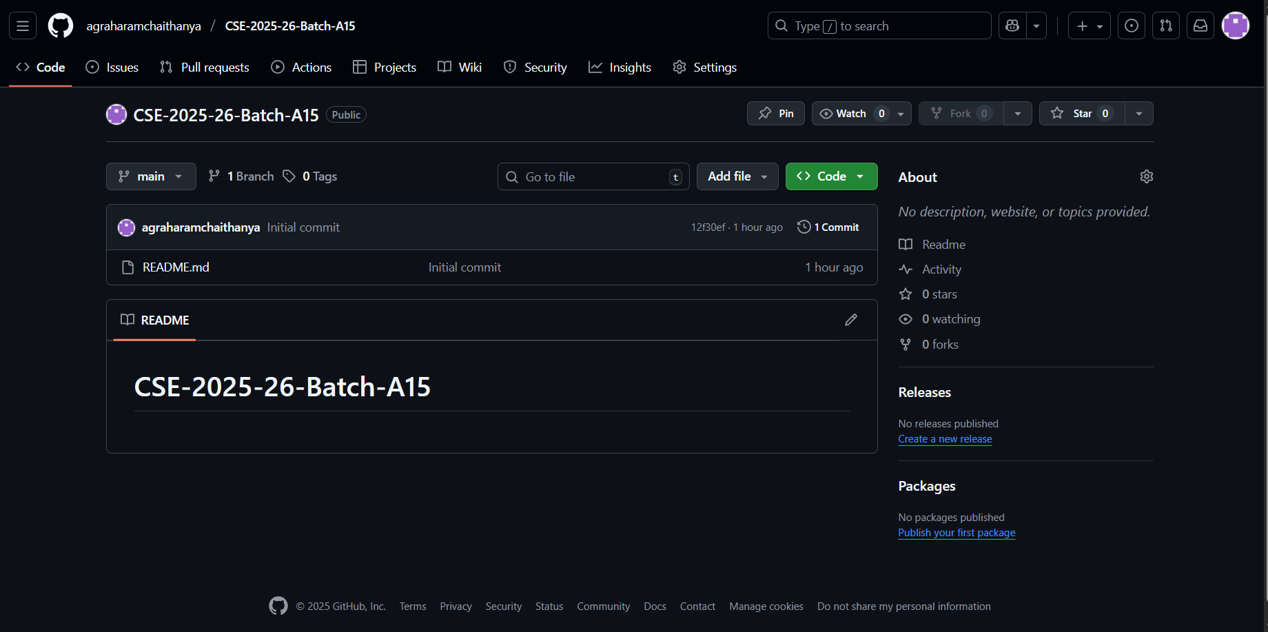
Git Hub Dashboards of each student
Green QR: Smart Information System
Github Link: https://github.com/agraharamchaithanya/CSE-2025-26-Batch-A15
Srinivasa Ramanujan Institute of Technology

Slide 11
Any Queries?
Green QR: Smart Information System
Srinivasa Ramanujan Institute of Technology

